Slide 1
Alumeconnect system
Guide:
Presented by:

Slide 2
Introduction
To address these challenges, the Alum Connect system will provide alumni with a platform that enables them to connect with each other, share information and experiences, and stay informed about institution-related news and events. The system will also provide the institution with a way to engage with its alumni and create a sense of community among them.

Slide 3
scope
This system can be used as an application for the Alumni Information Database to manage the college information and student’s information.
The system is an online application that can be accessed throughout the organization and outside customers as well with proper login provided, which will give better service to the customers.
It is completely automated system in handling the college database
This system provides centralized database maintenance
This system provides easy access to the particular students account or his complete details
This system provides student to easily navigate through the application for more information in a most secure manner.

Slide 4
Problem statement
The problem that the Alum Connect system aims to solve is the lack of a centralized platform that allows alumni to connect with each other and stay engaged with their alma mater.
Currently, alumni may have to rely on social media platforms or personal networks to keep in touch with each other, which can be inefficient and may not allow for easy access to relevant information about the institution. Additionally, alumni may not be aware of or have easy access to the institution's events and activities, which can limit their participation and engagement.

Slide 5
Objective
To build a system that will be able to manage alumni data of a college and provide easy access to the same.
To reduce manual work.
To provide user-friendly interface.
Quick data retrieval and large amount of data storing.
To allow old and new students of a university or college to communicate with each other.
This allows students to know about each other and their current activities.

Slide 6
EXISTING SYSTEM
Existing system is a manual one in which users are maintaining document’s paper work to store the information like colleges details, student details.
It is very difficult to maintain historical data.
It is difficult to maintain important information in documents paper work.
More manual hours need to generate required reports.
It is tedious to manage historical data which needs much space to keep all the previous years, ledgers, documents paper work.

Slide 7
Disadvantages
The existing methods analyzed that the low trust value of a user indicates that the information spread by the user is considered as untrustworthy.
These studies consider user profile features, which can easily be modified by malicious bots. To avoid feature manipulation.
Moreover, profile features and social interaction features may not help in detecting malicious URL

Slide 8
PROPOSED SYSTEM
To address these challenges, the Alum Connect system will provide alumni with a platform that enables them to connect with each other, share information and experiences, and stay informed about institution-related news and events. The system will also provide the institution with a way to engage with its alumni and create a sense of community among them.

Slide 9
Advantages
To reduce manual work.
To provide user-friendly interface.
Quick data retrieval and large amount of data storing.

Slide 10
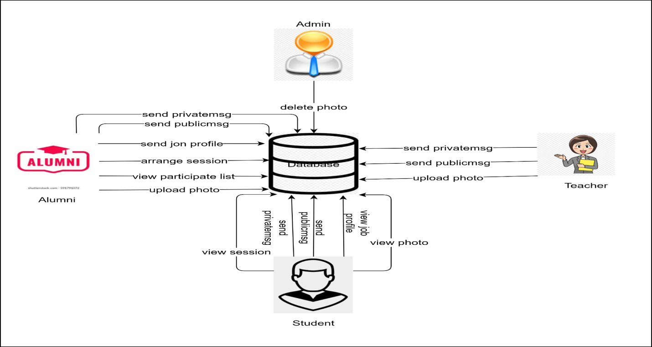
System Design

Slide 11
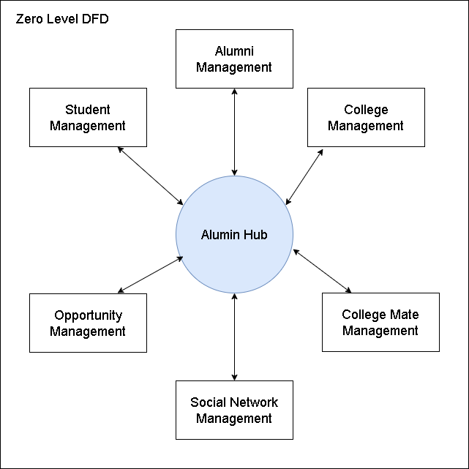
UML Diagram

Slide 12
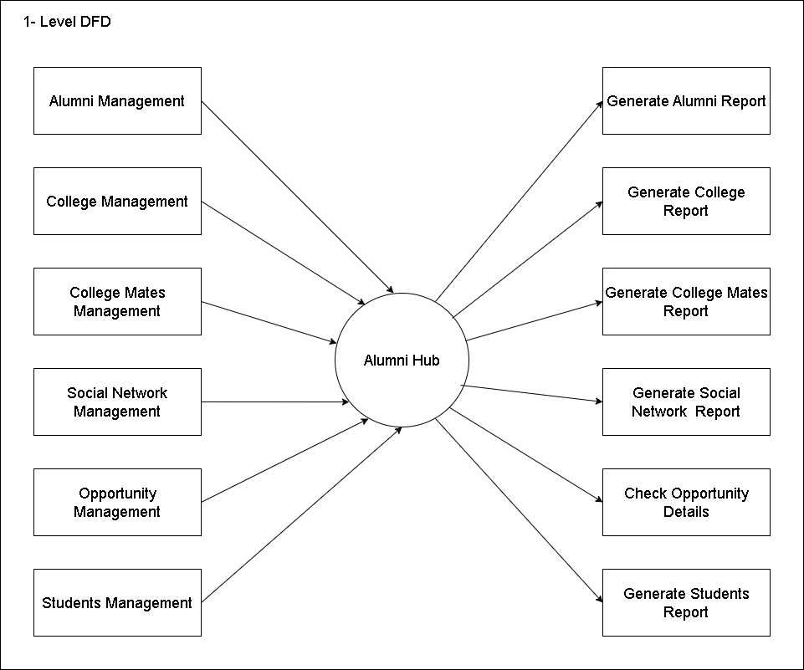
DFD 2

Slide 13
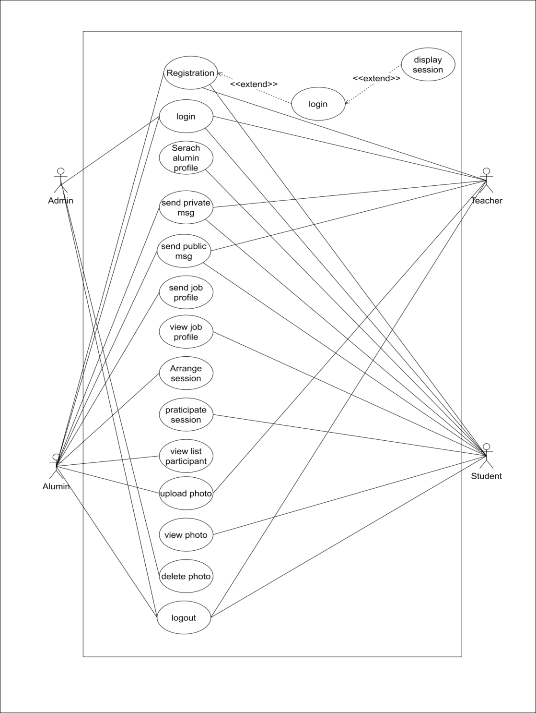
Use case

Slide 14
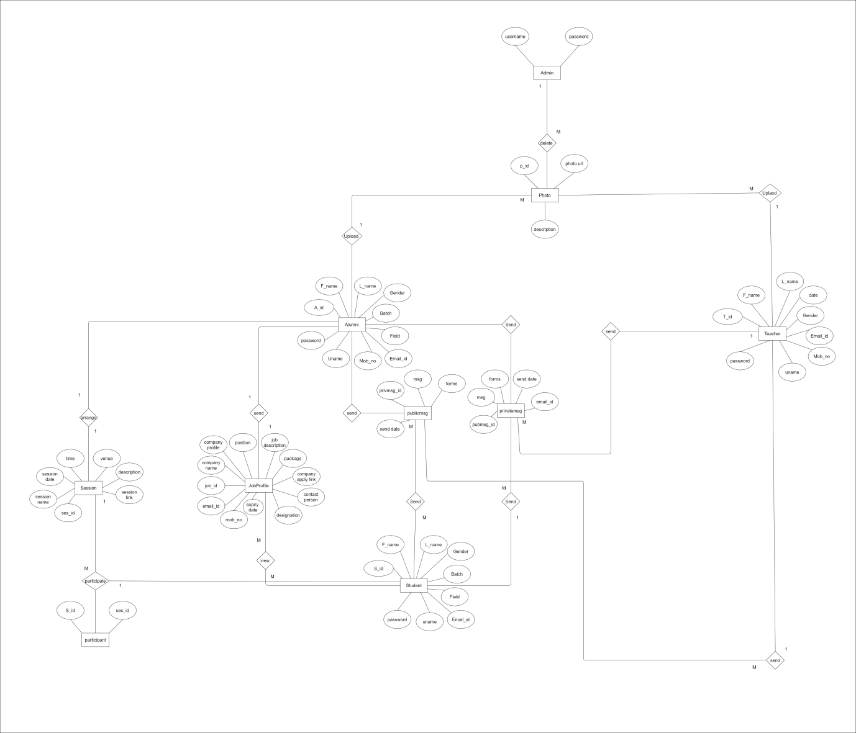
ER DIGRAM

Slide 15
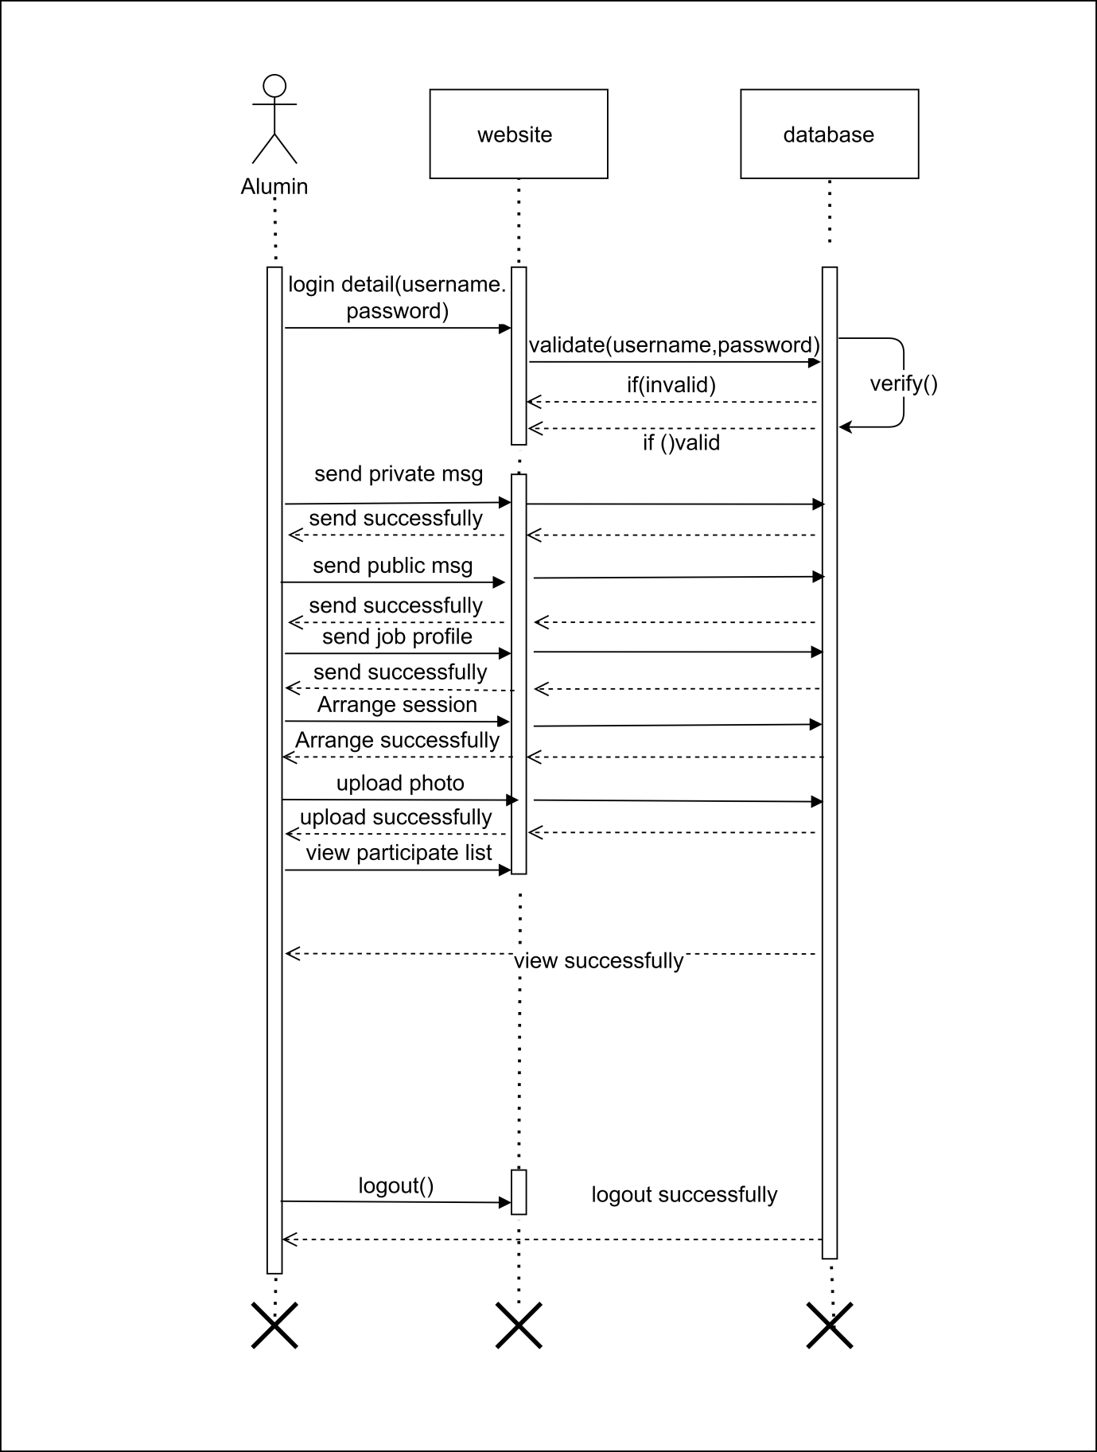
Admin sequence Diagram

Slide 16
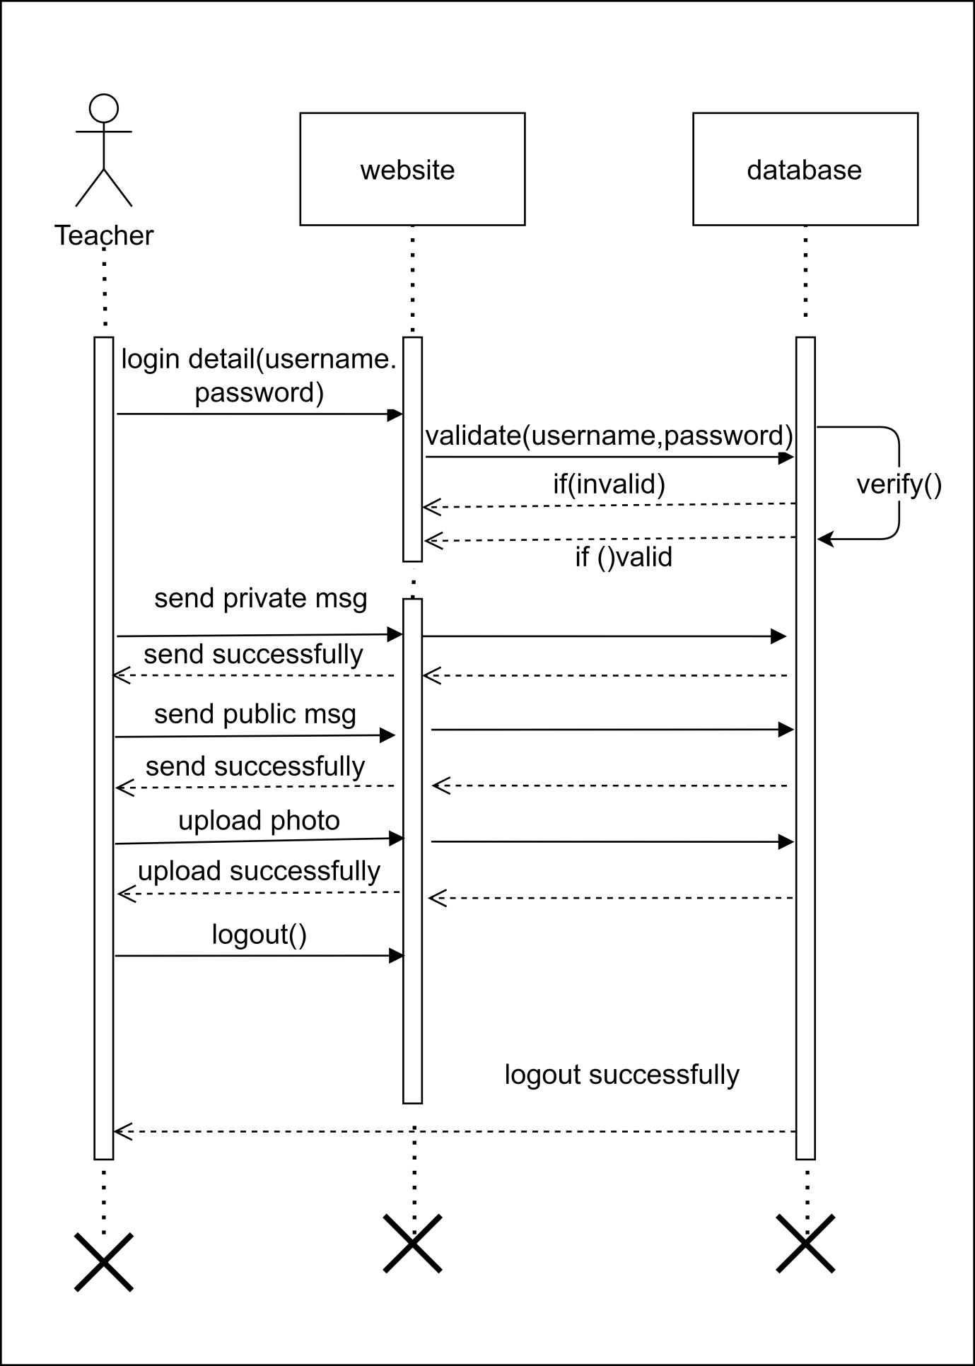
Teacher sequence

Slide 17
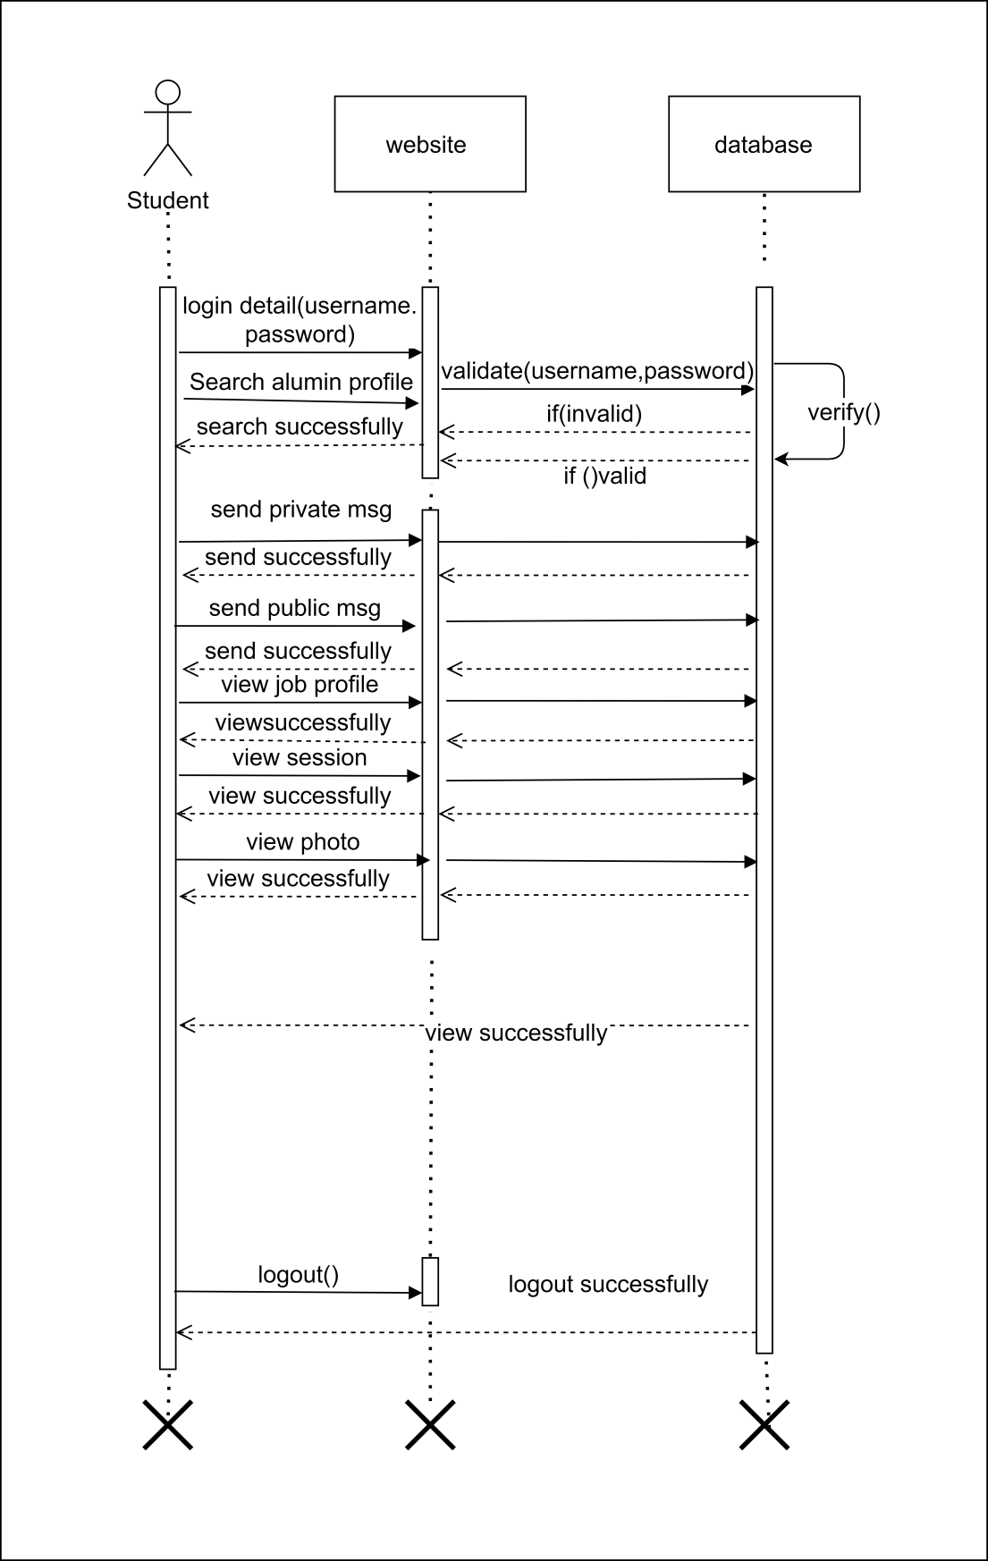
Student sequence

Slide 18
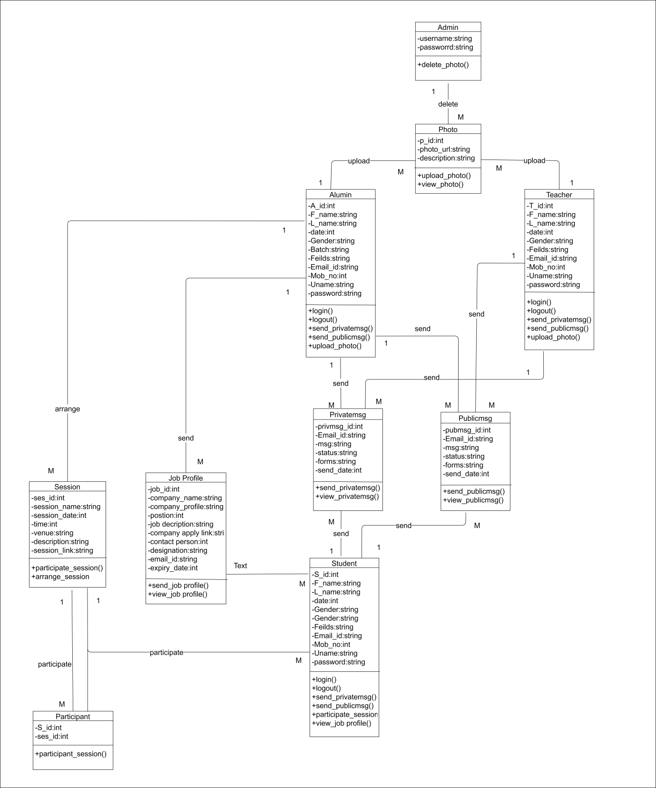
Class Diagram

Slide 19
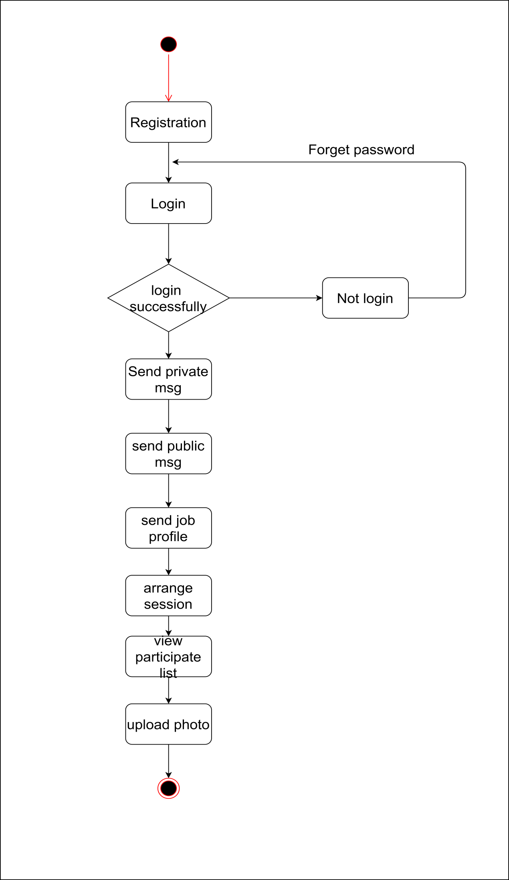
Activity Diagram

Slide 20
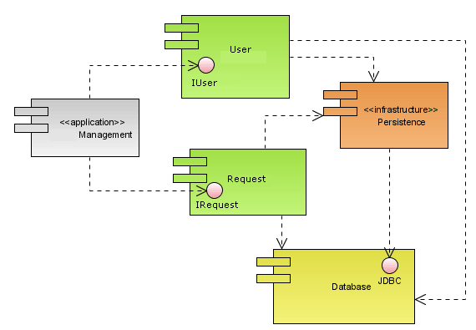
Component Diagram

Slide 21
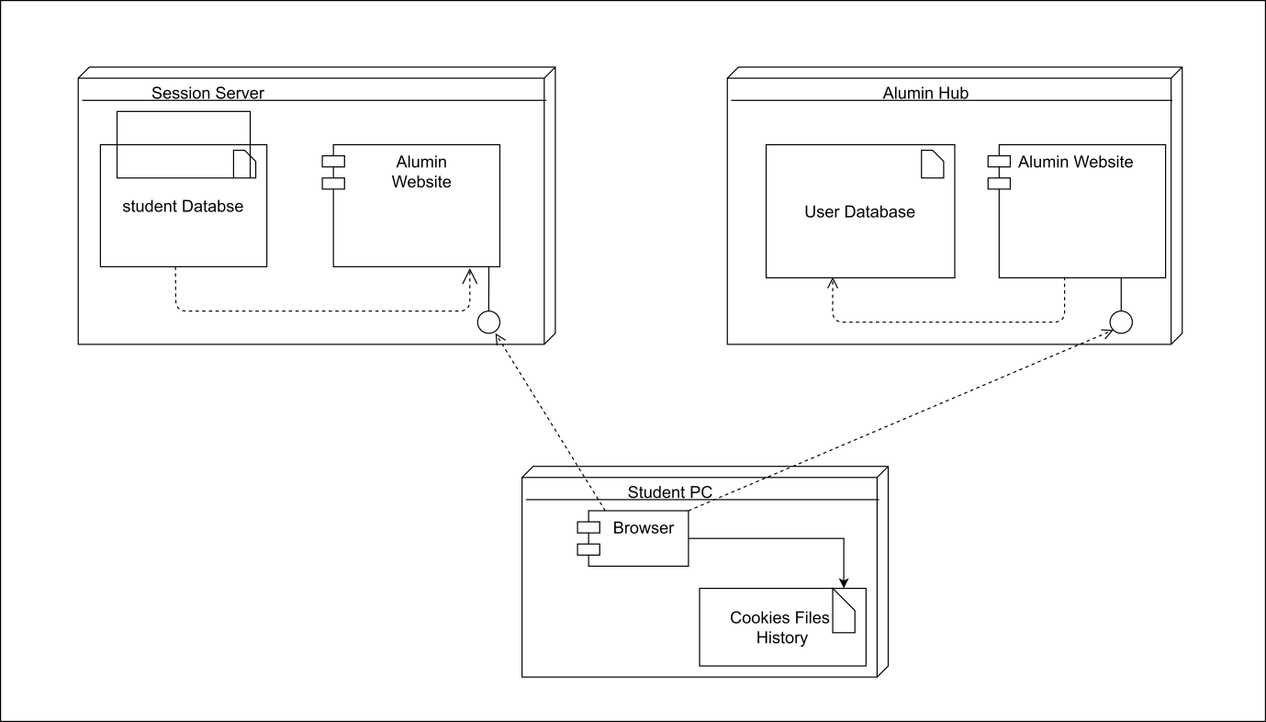
Deployment Diagram

Slide 22
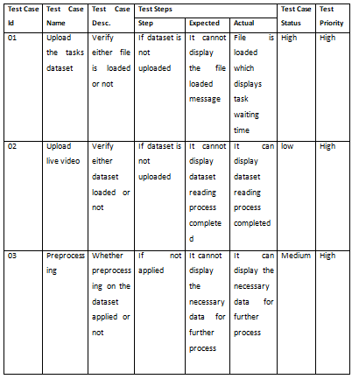
Test case

Slide 23
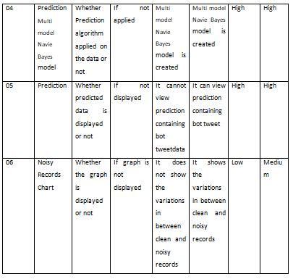
Test case

Slide 24

Add Screenshots

Slide 26
Hardware requirements
System : Pentium IV 2.4 GHz.
Hard Disk : 100 GB.
Monitor : 15 VGA Color.
Mouse : Logitech.
RAM : 1 GB.

Slide 27
Software requirements
Operating system : Windows XP/7/10
Development framework : flask framework
Programming language : Java
Dataset : MYSQL,XAMPP
IDE : Eclipse Kepler
Frond End : JSP,HTML,CSS,Javascript

Slide 28
Conclusion
The Alum Connect System is a Java-based web application that provides a platform for alumni to stay connected with their alma mater and contribute to its growth.
The system offers a range of features, including Admin, Alumni module, Teacher module ,Student module. The platform is designed to be scalable, allowing institutions to customize it to their specific needs. Overall, the Alum Connect System is a valuable tool for educational institutions to maintain a connection with their alumni and support the career growth of their current students

Slide 29
REFERENCES
Barnard, Z. (2007). Online community portals for enhanced alumni networking (Doctoral dissertation, University of Johannesburg). Retrieved on April 2013 from http://152.106.6.200/handle/10210/851 Davidson-Shivers, G. V., Inpornjivit, K., & Sellers, K. (2004). Using alumni and student databases for program evaluation and planning. College Student Journal, 38(4), 510. Retrieved on May 25, 2013 from https://goo.gl/Ghonjl Davis, F. D. (1989). Perceived usefulness, perceived ease of use, and user acceptance of information technology. MIS quarterly, 319-340. Retrieved on May 3, 2014 from http://goo.gl/qxOmX

Slide 30
Thank You

